Slide 1
EEE 335 Principles of Operating Systems
Principles of I/O Software – Pt 1
(Modern Operating Systems 5.2 – 5.3)

Slide 2
Quick Review
What is burst mode?
On which stack is the state of the system saved when an interrupt occurs?
Notes:
Burst mode is a method in DMA where more than the “smallest” chunk of information is sent. The DMA controller acquires the bus and sends a large burst of information so as to induce less overhead from continually getting/releasing the bus. Disadvantage: may delay CPU from doing work
There are two basic choices for which stack to save the state of the system: the stack of the current process or a system stack in the kernel. The user stack is quick and easy, but may not be valid or may cause a page fault. The kernel stack is a good choice, but may induce an unnecessary TRAP to kernel mode (since there are many interrupts that are handled in user space)

Slide 3
Outline
Principles and goals of I/O software
Device Independence
Uniform Naming
Error Handling
Synchronous vs Asynchronous Transfers
Buffering
Shared vs Dedicated Devices
I/O Methods
Programmed I/O
Interrupt-Driven I/O
DMA I/O
I/O Software Structure (Part I)
Interrupt Handlers
Devices Drivers

Slide 4
Principles/Goals of I/O Software
Device Independence
Should be possible to write programs that can access any I/O device without having to specify the device in advance
For example: your program should not be substantially different whether you access a file from a:
hard drive,
USB drive,
phone
cloud service

Slide 5
Principles/Goals of I/O Software
Uniform Naming
The name of a file or device should be a string or integer and not depend on the device in any way
Error Handling
Errors should be handled as close to the hardware as possible
Controller→Device Driver→upwards
Many I/O errors are transient; trying again will generally remove the error
Notes:
Clearly Windows doesn’t achieve this goal. Depending on which drive you are using you have to specify it with a: c: e: etc...

Slide 6
Principles/Goals of I/O Software
Synchronous (Blocking) vs Asynchronous (Interrupt Driven) transfers
At the physical level, most I/O is asynchronous
The device signals an interrupt when ready
For the user, the program is usually much easier to create if the I/O is synchronous (blocking)
It is up to the operating system to make asynchronous transfers appear blocking to the user

Slide 7
Principles/Goals of I/O Software
Buffering
Data that comes off a device must often be collected before being given to its final destination
For example, a packet from a network must be examined to determine which process requested the packet
Data going to a device might also be buffered, consider streaming music to a Bluetooth speaker
Data is put into an output buffer to decouple the rate at which is it filled from the rate it is emptied

Slide 8
Principles/Goals of I/O Software
Sharable vs. Dedicated Devices
Some devices, such as disks, can be shared by multiple processes simultaneously. Multiple files can be opened at the same time without problem
Other devices, such printers may only have a single user until their job is complete
Dedicated devices can also introduce the problem of deadlocks

Slide 9
How is I/O Performed?
Three methods:
Programmed I/O
Interrupt-Driven I/O
DMA
This is from the point of view of the software, although it may involve some hardware aspects

Slide 10
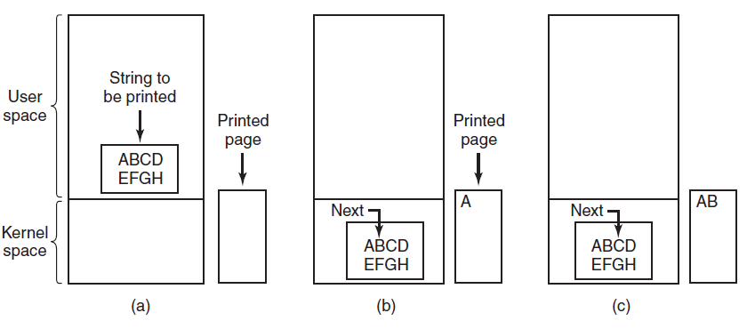
Programmed I/O
This is I/O through busy waiting
The OS has a process sitting in a loop, checking to see if the device is ready to communicate and sending/receiving information as required
Notes:
Here we see an array of information to be printed copied from user space to kernel space. This prevents having to change the memory map when going back to user space just to grab characters to print.
The kernel is checking to see if the device is ready for the next character before it is sent.
String gets put into a buffer in user space
This is a bit of a simplistic example as some printers may buffer a line or a page before actually printing anything
The point to make in this situation is that the OS will place information into one register (data register) then wait on the status register so it can send another (or block of) character(s).

Slide 11
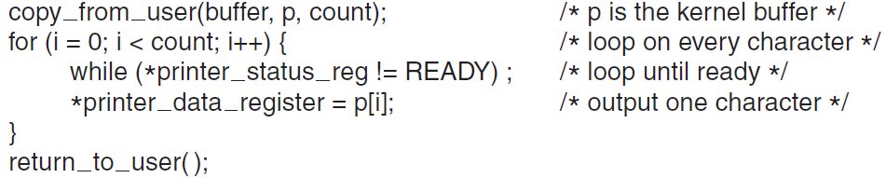
Programmed I/O
This method is simple to implement, but wastes a lot of CPU cycles
After outputting a character, the CPU continuously polls the device to see if it is ready to accept another one
If wait time is short (ie: printing goes to a buffer inside the printer) this could be acceptable
Also acceptable in an embedded system if there is not much else for the CPU to do
Notes:
Data is copied to kernel buffer
Loop through every character
Check to if device is ready
put a character in the data register
Consider if the printer is not buffering much and can print at most 100 char/s, that each character takes 10ms to print
That’s more than enough time to do a context switch and do something else!
Which leads us to....Interrupt driven I/O

Slide 12
Interrupt-Driven I/O
This method allows the CPU to do other work while I/O is pending
As before, the information to be printed is copied to kernel space
The printer is then fed the first character and the scheduler called to run another process (part of system call)
When the printer is ready for a character, an interrupt is generated and the printer interrupt service procedure executed

Slide 13
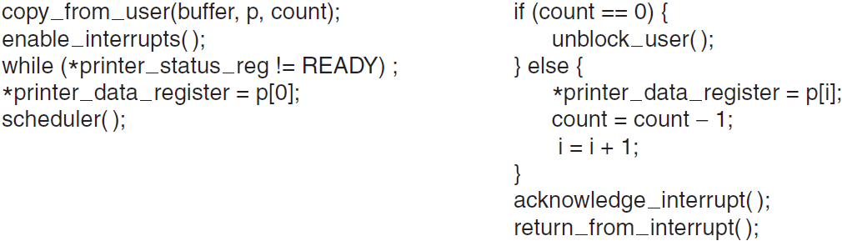
Interrupt-Driven I/O
Interrupt-Driven I/O
If the ISP (Interrupt Service Procedure) notes that there are no characters left to print the user process is unblocked
Could be through a message, semaphore, etc
System Call Code
Interrupt Service Procedure
Notes:
This is a crude “codular” example of how this might be implemented.
Ask them what happens though, if like in this example, the printer really is this crappy (as is our hardware interface to it) and we can only send one character at a time
Interrupts take time, and this would result in many interrupts, potentially in a very short bit of time.

Slide 14
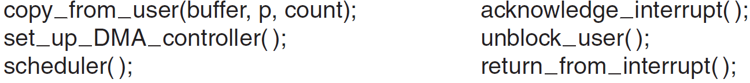
DMA I/O
I/O Using DMA
It is essentially using programmed I/O again, but the DMA controller is doing the work instead of the CPU
If the CPU is usually idle, then this method is less efficient than interrupts. Why?
System Call Code
Interrupt Service Procedure
Notes:
A case where DMA is not useful: No other processes is running then, since the CPU is usually faster than the DMA controller it can complete this transfer more expediently...and since it was idle anyway no gain is made by using DMA.
The biggest DMA advantage is the reduction of CPU interrupts.

Slide 15
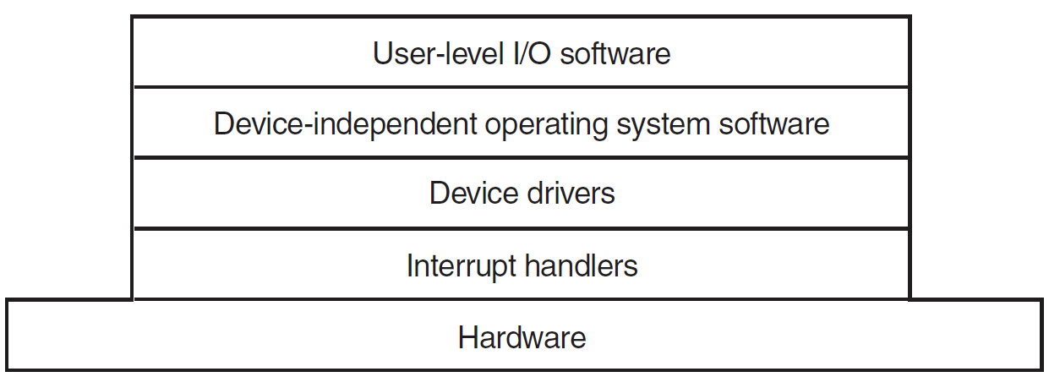
I/O Software Layers
How is I/O software organized?
Four levels, each more abstract from the hardware than the previous
Each layer has a well defined interface to its adjacent layer
Notes:
Since our previous discussion involved hardware, we’re going to work our way up this list from the hardware (controller) to the end user/programmer.
Remember our goals as we do this:
Device independence
Uniform naming
Error handling as close to hardware as possible
Block for user
Allow buffering
Allow sharing

Slide 16
I/O Software Layers: Interrupt Handlers
Interrupt Handlers
Interrupts must be used for at least part of dealing with I/O and should be hidden as far away from the user as possible, “in the bowels of the operating system”
Best way to deal with them is to have the driver block itself, by, for example:
a down on semaphore, or
a wait condition on a variable, or
a receive on a message
When the interrupt arrives, the interrupt service procedure unblocks the driver:
an up on a semaphore
signal on a condition variable
send a message to the driver
Notes:
So, this is the entire “job” of the interrupt...just to respond to the device being ready and informing the appropriate driver.

Slide 17
I/O Software Layers: Interrupt Handlers
Of course, it isn’t that simple. Much more has to be accomplished when responding to an interrupt
Save any registers that were not saved by hardware
Set-up a context for the interrupt-service routine (ISR) including: TLB, MMU, page table, and stack
Acknowledge the interrupt controller (or device if none)
Copy the registers from where they were saved to the process table
Run the ISR (get device info, unblock the driver, etc)
Choose next process to run and set up the MMU, TLB, registers, PSW, PC, etc for that process
Start running the newly selected process
Notes:
Note that I prefer the term ISR (Interrupt Service Routine) while the book uses ISP (Interrupt Service Procedure). Both are fine.
As can be seen, this is far from trivial and may take a significant number of instructions. All this just to unblock a driver!
These steps are system dependent; specific implementations may change some ordering or skip some steps completely!

Slide 18
I/O Software Layers – Device Drivers
Device Drivers
Each I/O device attached to the computer requires specific code to control it known as the device driver
This is because, at the hardware level, devices look radically different from one another
Sometimes one driver will handle a class of closely related devices. eg: a number of mice
The device driver is generally written by the device manufacturer and for a number of popular operating systems
Notes:
There is no technical reason why one driver couldn’t control a number of unrelated devices. It just isn’t good practice.

Slide 19
I/O Software Layers – Device Drivers
Device Drivers
Typically, drivers live in the kernel so they can access the control registers of the device
This isn’t a requirement, one could have device drivers in user space and have system calls for register communication
However, it is “the state of the practice”
Given that this is usually the method of implementing drivers, the standard architecture is to have the drivers “below” the bulk of the OS
Notes:
Having the IO driver in your application is not a wise modularization policy.
Taking the device drivers out of the kernel would remove a major source of bugs.

Slide 20
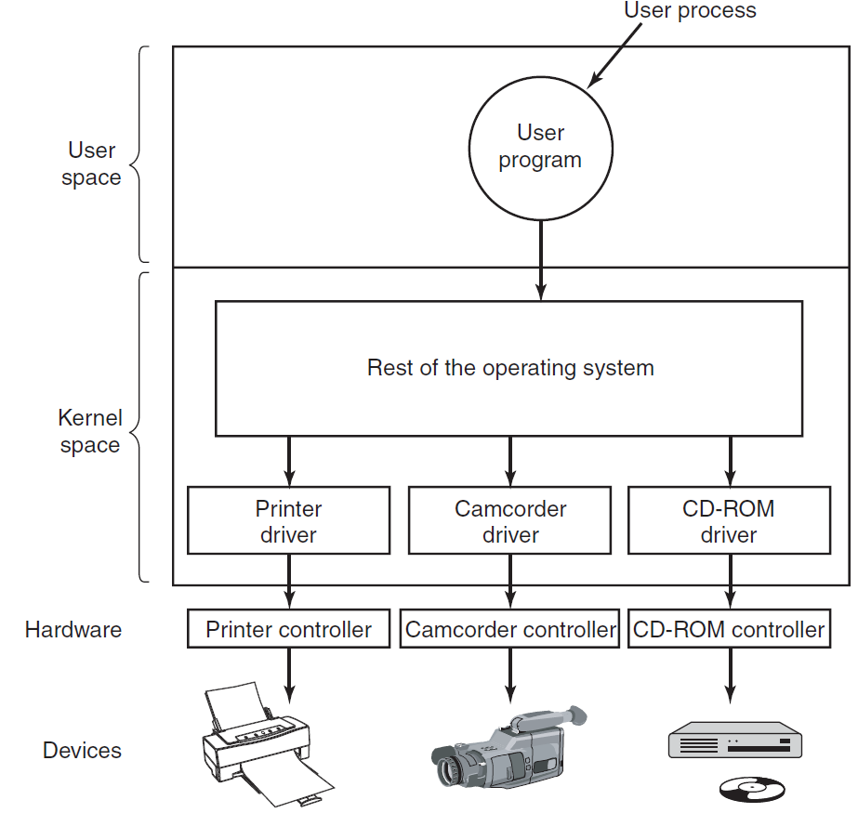
I/O Software Layers – Device Drivers
Not shown, but OSs usually require all block devices to support a standard set of interfaces and all character devices to support a different set

Slide 21
I/O Software Layers – Device Drivers
What do device drivers do?
Accept the abstract read/write commands from the layer above
Assorted functions:
Initialize the device
Manage its power
Notes:
Error

Slide 22
I/O Software Layers – Device Drivers
What does a driver do on a read/write?
Check input parameters & return errors
Convert abstract commands (read from sector) to physical terms (head, track, sector, and cylinder)
Queue requests if device is busy
Bring device to running status, if required
May need to get motor up to speed, etc...
Control the device by issuing a number of commands to it through the control registers

Slide 23
I/O Software Layers – Device Drivers
What does a driver do on a read/write?
Once request is issued one of two situations will occur:
The driver must wait for the request to complete, so it blocks. It will be awakened later, as described in the section on interrupts
The result is instantaneous(eg: writing to screen memory) so work is continued until all I/O is complete

Slide 24
I/O Software Layers – Device Drivers
Device Driver real-world complications:
Interrupt received for driver while performing I/O
May happen where a network packet being assembled and a new packet is received
Driver code must be reentrant in this case
Devices may be added/removed while computer is running.
USB is removed while driver is writing/reading!.
Notes:
reentrant : can be called second time while the first time is still being executed. Thread-safe!.

Slide 25
Quiz
What are the four layers of I/O software?
What are the three methods of I/O communication?
Notes:
What are the four layers of I/O software?
Interrupt Handlers
Device drivers
Device Independent I/O Software
User level I/O software
What are the three methods of I/O communication?
Programmed I/O (busy waiting)
Interrupts
DMA

Slide 26
Principle of I/O Software – Part II

